Slide 1
Managing Applications,
Services, and Disks
Lesson 4

Slide 2
Objectives
Skill/Concept | Exam Objective | Objective Number
Configuring Applications | Configure applications | 3.1
Managing Windows Store Apps | Configure applications | 3.1
Understanding Services | Understand services | 3.4
Using MSConfig (System Configuration Utility) | Configure native applications and tools | 1.3
Managing Processes and Applications with Task Manager | Configure native applications and tools | 1.3
Understanding Storage | Understand file systems Understand storage | 4.1 5.2
Encrypting and Compressing Files and Folders | Understand encryption | 4.3

Slide 3
Configuring Applications
A software program (also known as an app) is a sequence of instructions written to perform a specified task for a computer.
Today, most of these programs are installed as desktop apps or Windows Store apps.
Desktop apps are traditional apps, such as Microsoft Word or Excel.

Slide 4
Supporting Desktop Application Co-Existence (1/2)
Because Windows 10 follows the same architecture used in Windows Vista, Windows 7, and Windows 8/8.1, most applications written for Windows Vista, Windows 7, and Windows 8/8.1 will run on Windows 10.

Slide 5
Supporting Desktop Application Co-Existence (2/2)
The few applications that don’t run on Windows 10 are usually security-class applications or applications that bypass
the Windows API to communicate with system hardware by performing low-level kernel calls.
If an application doesn’t run in Windows 10, not even under the application compatibility mode, run the application under a Hyper-V virtual machine, a RemoteApp, or App-V.

Slide 6
Troubleshooting Program Compatibility
The Program Compatibility Troubleshooter is a wizard-based solution that users or administrators can use to automatically configure an executable file to use an appropriate Windows 10 compatibility mechanism.
Thus, the troubleshooter is not a compatibility mechanism in itself; it is simply a method for applying other mechanisms.

Slide 7
Configuring Startup Options
Some programs start or have a component (program and service) that starts during the Windows boot process.
Some programs allow the program to run faster; others are required for the program to function properly.
If you don’t want these programs to start during boot up or continually consume resources at all times, you need to know how to turn off or disable the startup programs.

Slide 8
Managing Windows Store Apps
Universal Windows Platform (UWP) apps are a special type of Windows Store apps that can be installed on multiple hardware platforms, such as a tablet that is running Windows 10 Pro, an Xbox One, or a Windows 10 Phone.
The Windows Store apps differ from traditional applications in that they are designed to run in a single, full window display across multiple form factor devices.

Slide 9
Configuring the Windows Store
The Windows Store provides a central location for you to purchase and download Windows apps that run on Windows 8 and later operating systems.
Windows Store apps do not run on Windows 7 or earlier versions of Windows. Windows Store apps tend to be smaller
and faster than desktop apps.
Notes:
A Microsoft account, previously called Windows Live ID, is a unique account that is the combination of an email address and a password that you use to sign in to services like Outlook.com, MSN.com, Hotmail.com, OneDrive, Windows Phone, or Xbox Live.

Slide 10
Understanding Group Policy and Network Application Installation (1/2)
Group Policy is a collection of settings (policies) stored in Active Directory on a Windows network.
Active Directory is an infrastructure (directory) that stores information and objects.
An object can be a file, a printer, a computer, a user account, or other entities.

Slide 11
Understanding Group Policy and Network Application Installation (2/2)
Objects in Active Directory are linked to Group Policy Objects (GPOs), which are used by administrators to control users and computers on a network and to deploy applications, software updates, and security.
Notes:
Take Note: Group Policy is supported in Windows 10 Professional and Enterprise editions.

Slide 12
Understanding Services (1/2)
Services run in the background on a Windows system to help the operating system run other programs.
The Services console is the central management point of services in Windows 10.

Slide 13
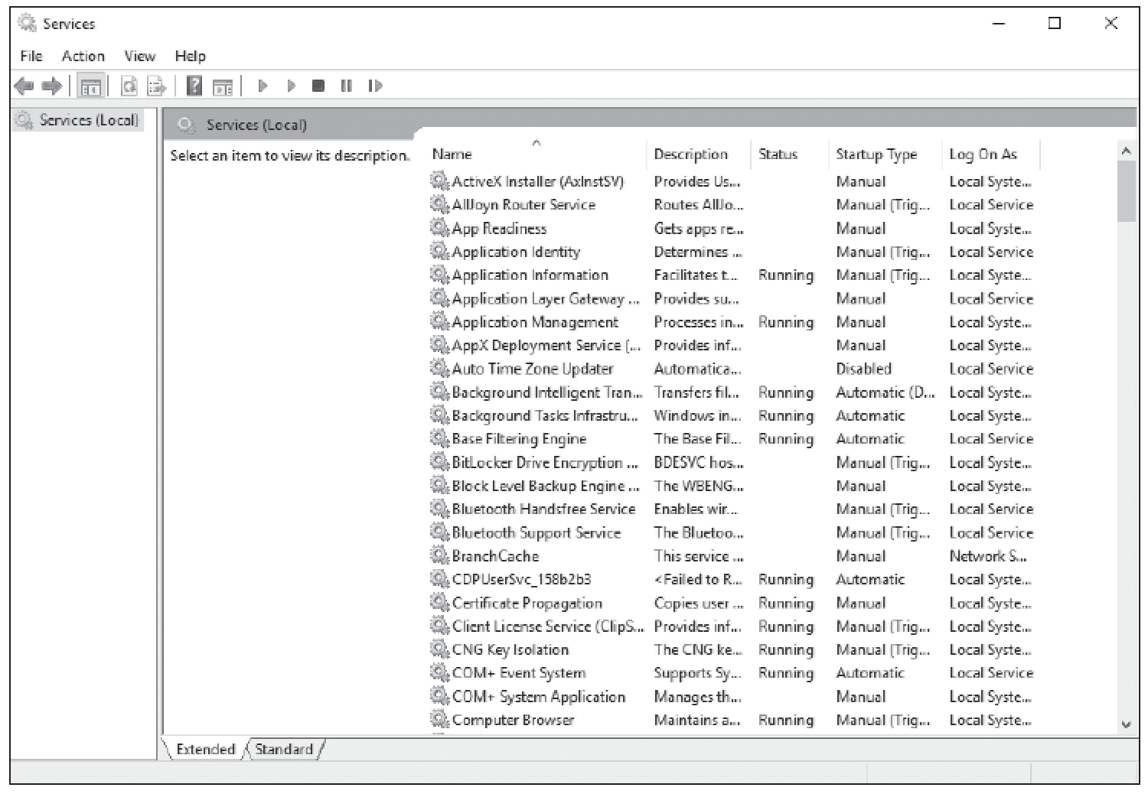
Understanding Services (2/2)

Slide 14
Using MSConfig
MSConfig, also known as the System Configuration utility, enables you to enable or disable startup services, set boot options such as booting into Safe Mode, access tools like Action Center and Event Viewer, and more.
You’ll use this utility mainly to troubleshoot startup problems with Windows.
Notes:
Group policies also exist in Windows 7 and other Windows operating systems. They are referred to as Local Group Policies and affect only the users who log on to a particular computer. This section focuses on Group Policy at the network domain level.

Slide 15
Managing Processes and Applications with Task Manager (1/2)
Task Manager gives you a quick glance at performance and provides information about programs and processes running on your computer.
A process is an instance of a program that is being executed.

Slide 16
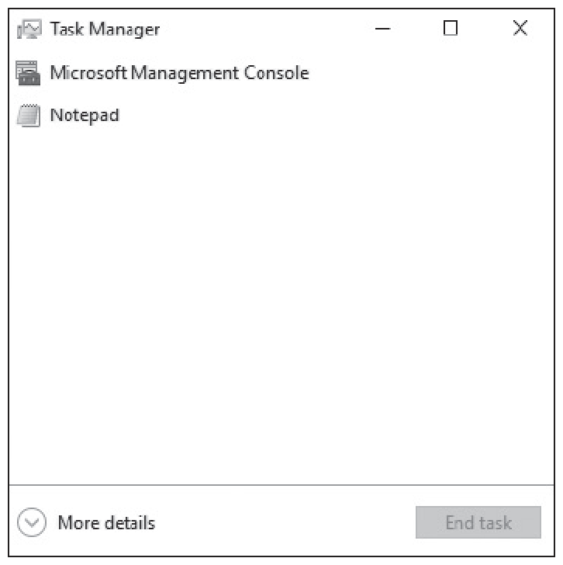
Managing Processes and Applications with Task Manager (2/2)

Slide 17
Understanding Storage
Storage in Windows 10 refers to storing data as well as an operating system on disks.
There are a number of different types of storage: internal, external, network, and cloud.

Slide 18
Understanding Disk and Drive Types
In Windows 10, a physical hard drive can be designated as a basic disk or a dynamic disk.
Basic disks contain only simple volumes.
Dynamic disks can contain simple, spanned, striped, and mirrored volumes.

Slide 19
Understanding File Systems
The three primary types of file systems for Windows are FAT, FAT32, and NTFS.
It’s best to use NTFS-formatted disks for Windows Vista through Windows 10 because NTFS handles small to very large hard disks, provides better security, and is the most reliable.

Slide 20
Using Disk Management (1/2)
When you add a new hard drive to a computer, there are a few steps you need to take to introduce a new drive to the operating system.
You need to initialize the disk and then choose a drive type and a partition style (for basic disks).
You can perform all of these steps in the Disk Management tool, which is part of the Computer Management MMC
snap-in.

Slide 21
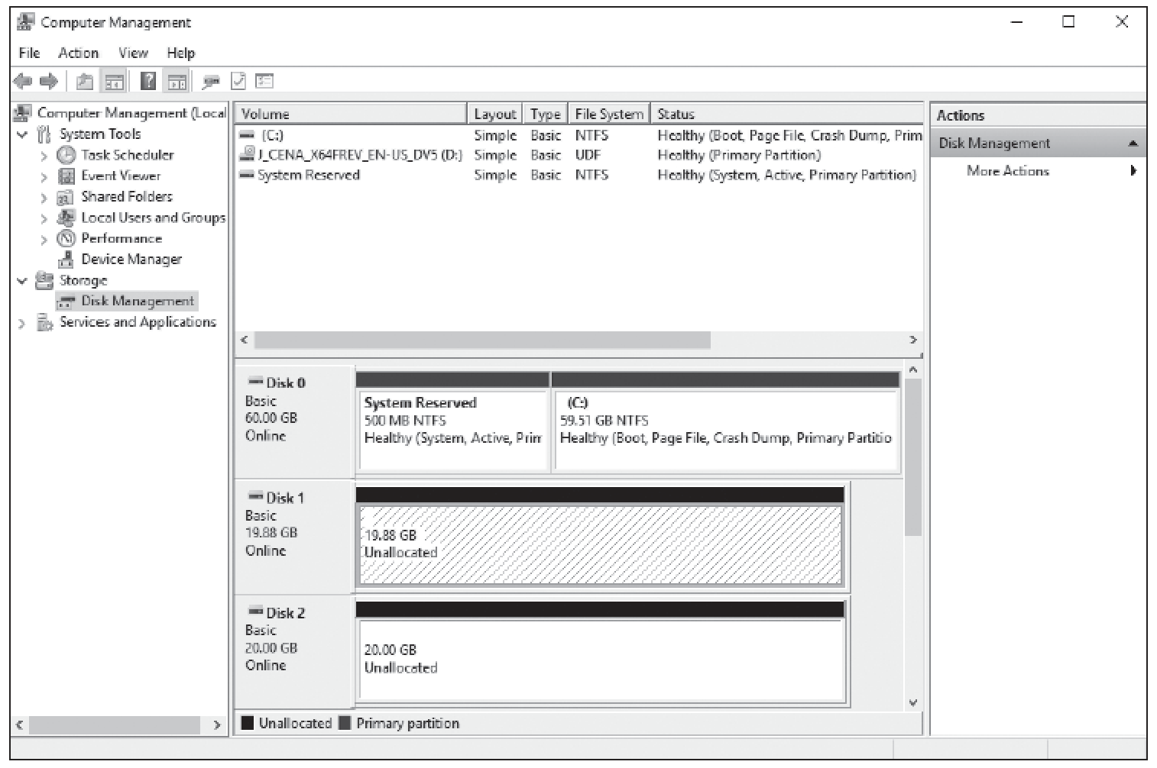
Using Disk Management (2/2)

Slide 22
Encrypting and Compressing Files & Folders
Encrypting files and folders protects them from unwanted access.
Microsoft uses EFS to encrypt individual files and folders.
Encryption protects the contents of files and folders from unauthorized access.
Compression is the process of decreasing the size of files or folders without affecting the files’ contents.
Notes:
Take Note: You cannot encrypt files or folders that are compressed. If you want to encrypt a compressed file or folder, you must decompress it first.

Slide 23
Understanding BitLocker
BitLocker Drive Encryption is another method of protecting data stored on a fixed drive in a Windows computer.
BitLocker encrypts the entire drive, rather than individual files and folders.
The complementary BitLocker To Go protects data on removable data drives, such as an external flash drive.
Notes:
Take Note: BitLocker encryption is available only in Windows 10 Professional, Enterprise, and Education editions.

Slide 24
Summary (1/5)
A software program (also known as an app) is a sequence of instructions written to perform a specified task for a computer.
Today, most of these programs are installed as desktop apps or Windows Store apps. Desktop apps are traditional apps, such as Microsoft Word or Excel.

Slide 25
Summary (2/5)
The Program Compatibility Troubleshooter is a wizard-based solution that users or administrators can use to automatically configure an executable file to use an appropriate Windows 10 compatibility mechanism.
Thus, the troubleshooter is not a compatibility mechanism in itself; it is simply a method for applying other mechanisms.

Slide 26
Summary (3/5)
The Windows Store provides a central location for you to purchase and download Windows apps that run on Windows 8 and later operating systems.
Windows Store apps do not run on Windows 7 or earlier versions of Windows.
Windows Store apps tend to be smaller and faster than desktop apps.
Services run in the background on a Windows system to help the operating system run other programs. The Services console is the central management point of services in Windows 10.

Slide 27
Summary (4/5)
When it comes to Windows storage, there’s more to it than just saving data on a disk.
There are different types of disks (basic and dynamic) you need to know about, along with choices of partition styles such as the master boot record (MBR) and GUID partition table (GPT), which determine the number of partitions you are allowed to create along with the size limitations of those partitions.

Slide 28
Summary (5/5)
Encryption protects the contents of files and folders from unauthorized access.
Windows uses Encrypting File System (EFS) to allow users to encrypt information on hard disks, external flash drives, CDs, DVDs, backup tapes, and other types of physical media.
BitLocker Drive Encryption is another method of protecting data stored on a fixed drive in a Windows computer.

